Slide 1

Implementing Cross-Enterprise Document Sharing (XDS) based on Blockchain Technology
Petnathean Julled
Progress 30 Dec. 2020

Slide 2
What have done and working on, so far (Implementation)
Code smartcontract to store META-data attributes of health document following IHE Cross-Enterprise Document Sharing (XDS) format for Document Registry Actor.
Prepare “Quorum” (Ethereum forked) which allow Istabul-Byzantine False Tolerance and enable 7 Nodes sample for demonstration deployment
Process regarding publishing and interacting with smartcontract
Deploying smartcontract using NodeJS
Interact with deployed smartcontract using NodeJS
Connect XDS Transaction with smartconrtact (using NodeJS)
Create TCP Socket program (which will act as XDS Transaction receiver)
Create XDS Transaction Interpreter which convert XML message into JSON allowing transition to smartcontract
Combine XDS Transaction receiver program with interpreter program before interact with smartcontract
Create “Search program” which will allow search operation on smartcontract (which act as XDS Document Registry)
Create program which will return search result as XML message following XDS Transaction format [ITI-18]
Create simple UI for demonstration

Slide 3







Design Overview
XDS Blockchain
Registry Query [ITI-18] <XML>
Search
Smart Contract
Interpreter
Add
Responder
Query Result <XML>
Read
Ethereum Blockchain Ledger
Interpreter & Simplifier
Register Document Set-b [ITI-42] <XML>

Slide 4
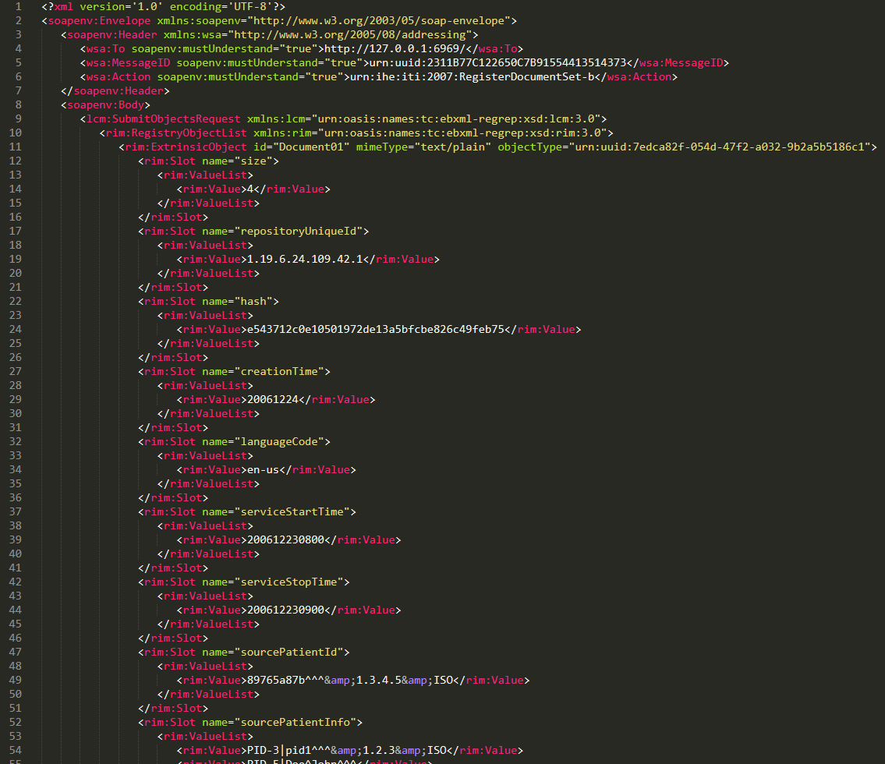
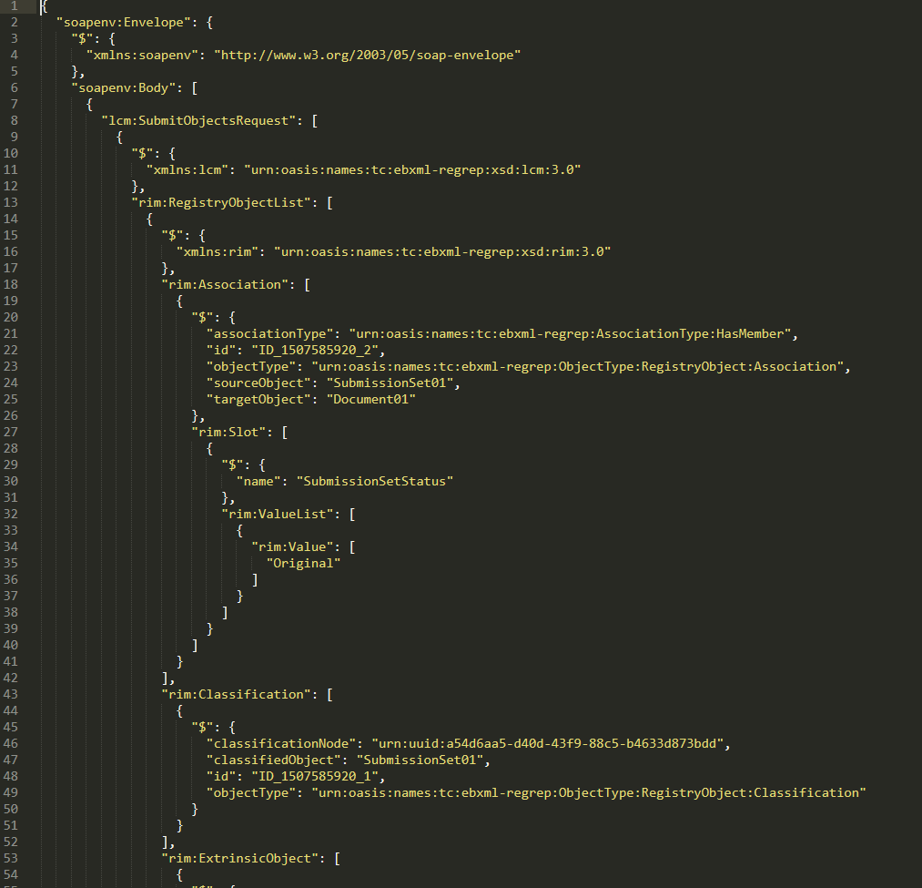
Successfully convert XML message into JSON
XML message
(IHE XDS ITI-42 Transaction Sample)
JSON

Slide 5
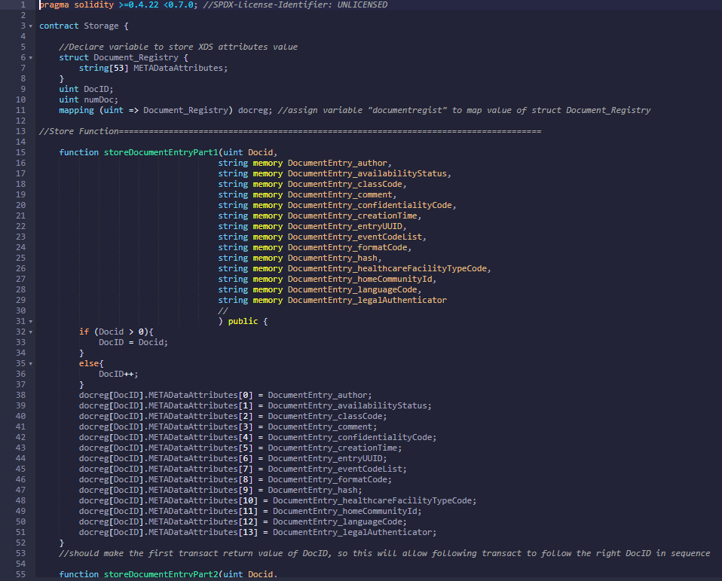
Smartcontract made to act as XDS Document Registry
Variables storing
META-Data attributes of Health Document
inside smartcontract
Passing value from JSON into smartcontract
Provide simpler method to access value
by search operation and for returning result

Slide 6
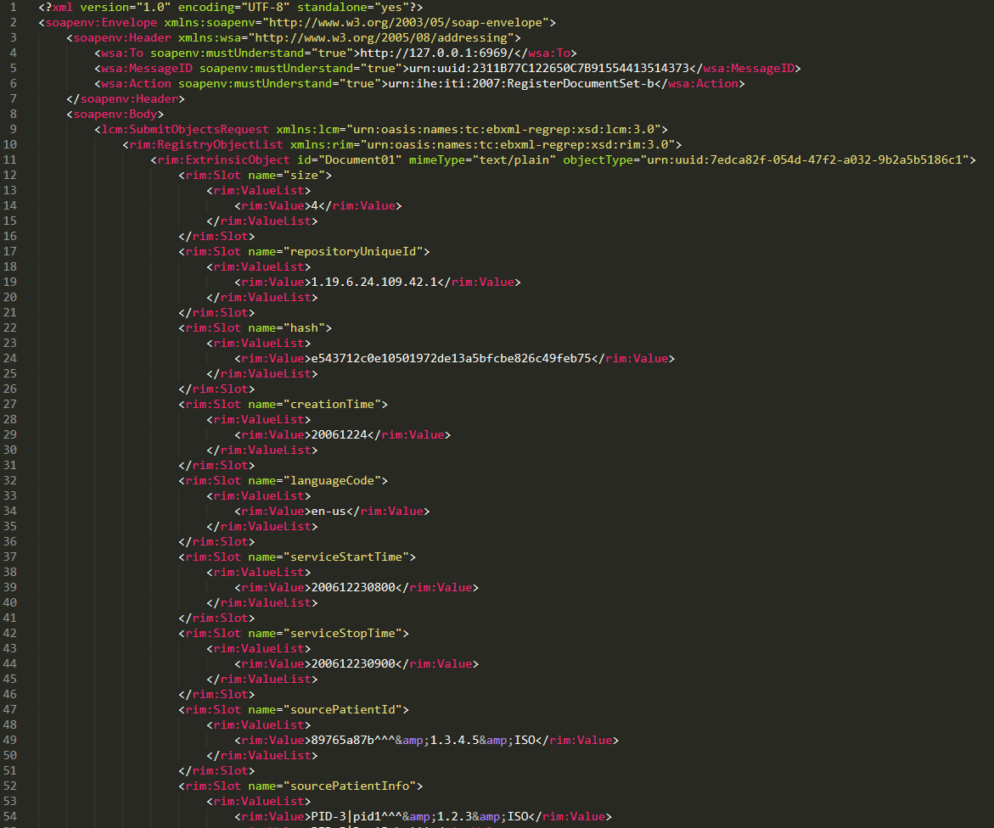
Rebuild XML message from JSON
JSON
Rebuild XML message from JSON
(IHE XDS ITI-42 Transaction format)

Slide 7
Next Step
Task | Month | January |  |  |  |  | February |  |  |  | M
 | Week | 1 | 2 | 3 | 4 | 5 | 1 | 2 | 3 | 4 | -
Connect XDS to smartcontract (Finishing)
Create “Search” Program
Create “Search Result Returner” Program
Create simple UI for demo
Paper re-write (Finishing)
Thesis writing
Preparation and defense exam

